Slide 1



Wakanda
Build web and mobile business apps
with a complete JavaScript stack
Notes:
© SUPINFO International University - http://www.supinfo.com
SUPINFO vous permet de partager ce document
Vous êtes libre de :
Partager — reproduire, distribuer et communiquer ce document Remixer — modifier ce document
A condition de respecter les règles suivantes :
Indication obligatoire de la paternité — Vous devez obligatoirement préciser l’origine « SUPINFO » du document au début de celui-ci de la même manière qu’indiqué par SUPINFO International University – Notamment en laissant obligatoirement la première et la dernière page du document, mais pas d'une manière qui suggérerait que SUPINFO International University vous soutiennent ou approuvent votre utilisation du document, surtout si vous le modifiez. Dans ce dernier cas, il vous faudra obligatoirement supprimer le texte « SUPINFO Official Document » en tête de page et préciser notamment la page indiquant votre identité et les modifications principales apportées.
En dehors de ces dispositions, aucune autre modification de la première et de la dernière page du document n’est autorisée.
NOTE IMPORTANTE : Ce document est mis à disposition selon le contrat CC-BY-NC-SA Creative Commons disponible en ligne http://creativecommons.org/licenses ou par courrier postal à Creative Commons, 171 Second Street, Suite 300, San Francisco, California 94105, USA modifié en ce sens que la première et la dernière page du document ne peuvent être supprimées en cas de reproduction, distribution, communication ou modification. Vous pouvez donc reproduire, remixer, arranger et adapter ce document à des fins non commerciales tant que vous respectez les règles de paternité et que les nouveaux documents sont protégés selon des termes identiques. Les autorisations au-delà du champ de cette licence peuvent être obtenues à support@supinfo.com.
© SUPINFO International University – EDUCINVEST - Rue Ducale, 29 - 1000 Brussels Belgium . www.supinfo.com

Slide 2

Wakanda
Course objectives
By completing this course, you will be able to:
Explain what Wakanda is
Use datastore to manipulate data
Expose your data through HTTP REST
Take advantage of events in Wakanda

Slide 3


Wakanda
Course topics
Course’s plan:
What is Wakanda ?
Datastore
HTTP REST
Dataprovider
Datasource

Slide 4
What is Wakanda ?
Wakanda

Slide 5
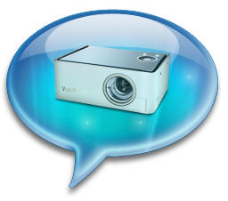
Introduction
From the browser to the server
An open‐source platform
Provides a unified stack running on JavaScript from end‐to‐end
Allows you to develop business web applications

Slide 6
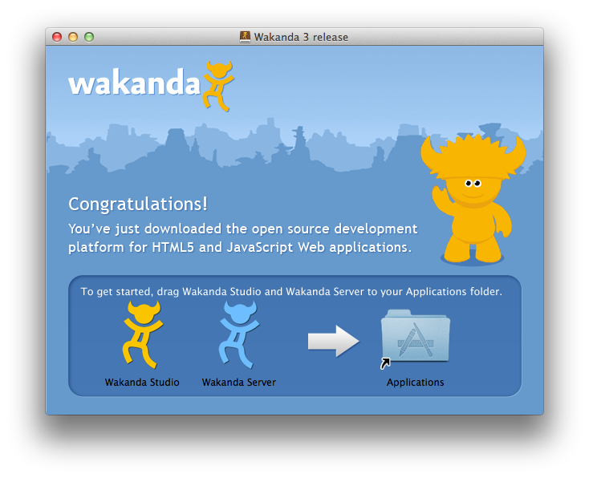
Introduction
From the browser to the server
The platform is comprised of :
Wakanda Server
Wakanda Studio
Wakanda Client Framework

Slide 7
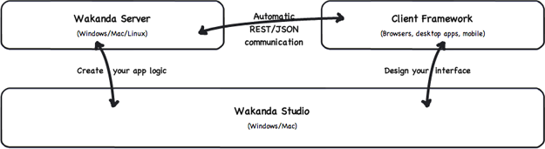
Introduction
Wakanda Architecture

Slide 8
Introduction
Wakanda Server
Wakanda Server is made up of several parts :
The Datastore
House all your application data (NoSQL Database)
The Datastore Engine
Contain the datastore classes (Entities) you’ve defined and your server side JavaScript (Business logic)
HTTP Server
Deliver content to the outside world

Slide 9
Introduction
Wakanda Studio
Wakanda Studio is the IDE of the platform
It is comprised of :
Solution Manager
Datastore Model Designer
GUI Designer
Code Editor

Slide 10
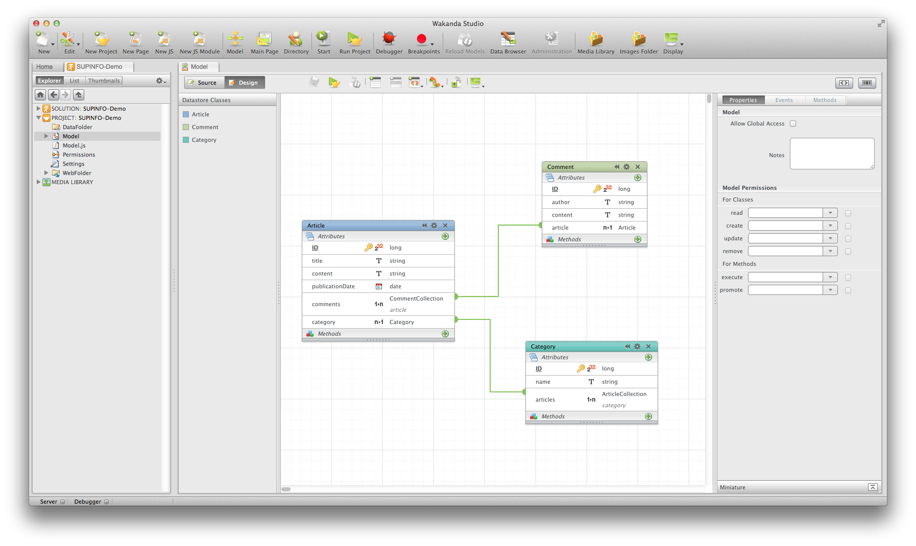

Slide 11
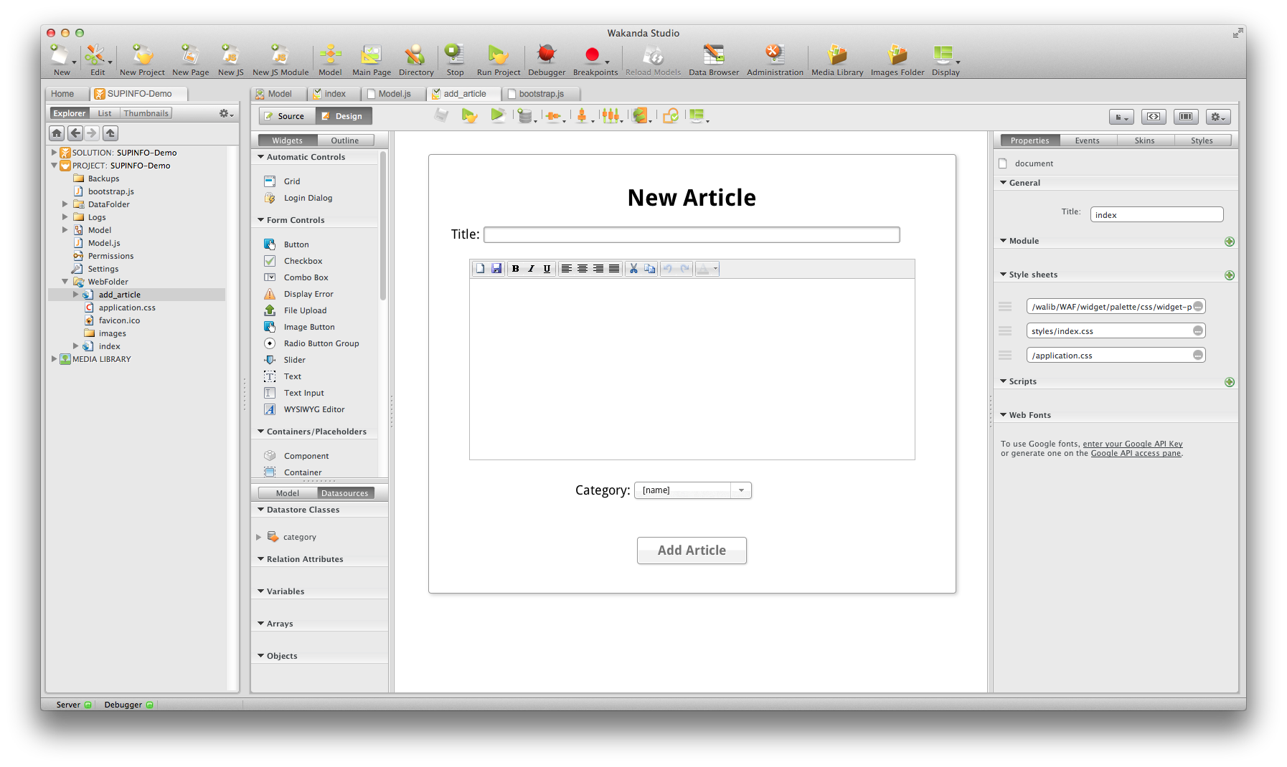

Slide 12
Introduction
Wakanda Studio
Wakanda Studio is the IDE of the platform
It is comprised of :
Solution Manager
Datastore Model Designer
GUI Designer
Code Editor

Slide 13
Introduction
Wakanda Client Framework (WAF)
Wakanda provide an advanced client-side Framework made up of :
A data provider to communicate with the server
Widgets on the browser-based front-end, and a datasource between them

Slide 14
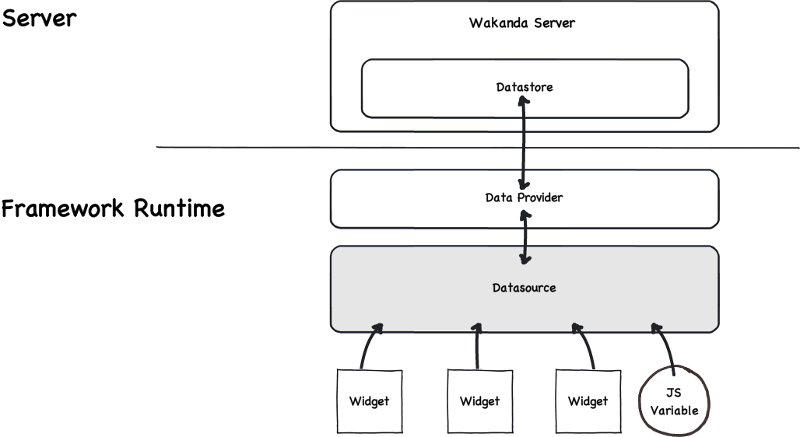
Introduction
Wakanda Client Framework (WAF)

Slide 15
Introduction
Wakanda Client Framework (WAF)
Data provider communicates directly with the server through REST APIs
Data is then passed to the datasource that sends and receives data to and from widget

Slide 16
Introduction
Wakanda Client Framework (WAF)
Widgets are interface elements based on HTML, CSS and JavaScript
Wakanda provide a variety of them
You can customize them or create your owns

Slide 17


Questions ?

Slide 18
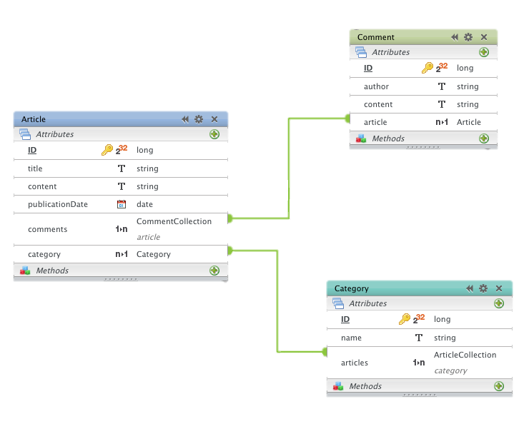
Datastore
Wakanda

Slide 19
Introduction
Datastore model
The Wakanda database is called WakandaDB
An Object datastore NoSQL engine
Stores directly objects with dependencies between them
No tables, no rows, no SQL ☺

Slide 20
Introduction
Datastore model
Data becomes more simple and development more efficient
Don’t need to lose time with DB Schema, SQL queries or to use an ORM
Your records are already objects!

Slide 21
Introduction
Datastore API
A server-side API that allows you to:
Perform searches or sorts on the entities in a datastore class
Manage transactions

Slide 22
Introduction
Datastore API
A server-side API that allows you to:
Create, modify or delete entities
Obtain various pieces of information about the model and data in your DB

Slide 23
Introduction
Datastore API
The API contains different classes:
Datastore
Dataclass
Entitycollection
Entity
We’re going to see each of them…

Slide 24
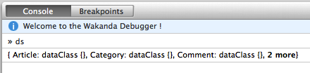
Introduction
Datastore class
Provides various utility properties and methods to manage datastores and transactions
You can use it through an implicit variable named ds available inside your server-side scripts
Notes:
http://doc.wakanda.org/Datastore/Datastore.201-590315.en.html

Slide 25
Introduction
Datastore class
Datastore object is used to retrieve Dataclass objects
Available data classes are properties of ds
var articleDataClass = ds.Article;
var categoryDataClass = ds.Category;
var anotherModelDataClass = ds.AnotherModel;
Notes:
http://doc.wakanda.org/Datastore/Datastore.201-590315.en.html

Slide 26
Introduction
Dataclass class
Provides basic methods to manage and create entities :
EntityCollection all( )
Returns an EntityCollection containing all the entities in the datastore class to which ti was applied
var newCategories = ds.Category.all();

Slide 27
Introduction
Dataclass class
Provides basic methods to manage and create entities :
Entity createEntity( )
Creates a new blank object of type Entity based on the datastore class to which it is applied
var newCategory = ds.Category.createEntity();
newCategory.name = "Cinema";

Slide 28
Introduction
Dataclass class
Provides basic methods to manage and create entities :
Array distinctValues( String attribute )
Creates an array and returns in it all the distinct values stored in attribute for the datastore
var jobNb = ds.Job.distinctValues("name").length;

Slide 29
Introduction
Dataclass class
Provides basic methods to manage and create entities :
Entity find( String queryString )
Applies the search criteria to all the entities and return the first entity found
var job = ds.Job.find("name = Developer");

Slide 30
Introduction
Dataclass class
Provides basic methods to manage and create entities :
EntityCollection query( String queryString )
Applies the search criteria to all the entities and return all matching entities
var jobs = ds.Job.query("name = Developer");

Slide 31
Introduction
Dataclass class
Provides basic methods to manage and create entities :
The list of the other methods and properties is available here:
http://doc.wakanda.org/Datastore/Datastore-Class.201-595978.en.html

Slide 32
Introduction
Entitycollection class
Represent a set of entities that belong to the same dataclass
Typically, returned from the datastore by query( ) or all( ) methods
Use the JavaScript array syntax enriched by some useful methods

Slide 33
Introduction
Entitycollection class
Array syntax example :
var nbJob = myJobCollection.length;
var myJob0 = myJobCollection[0];
var myJob3 = myJobCollection[3];

Slide 34
Introduction
Entitycollection class
Some useful methods:
Array distinctValue( String attribute )
Entity find( String queryString )
Entitycollection query( String queryString )
The list of the other methods and properties is available here:
http://doc.wakanda.org/Datastore/Entity-Collection.201-596841.en.html

Slide 35
Introduction
Entity class
Contains specialized methods for working with entities:
void getKey( )
Returns the PK value of the entity to which it is applied
void refresh( )
Reloads the entity as it is stored in the datastore

Slide 36
Introduction
Entity class
Contains specialized methods for working with entities:
void remove( )
Removes the entity from the datastore
void save( )
Saves the changes made to the entity in the datastore

Slide 37
Introduction
Entity class
Entity classes also provide a constructor to create new instances:
var employee = new ds.Employee();
employee.lastname = 'Lorrain';
employee.firstname = 'Aurélie';
var employee = new ds.Employee({
lastname: 'Lorrain',
firstname: 'Aurélie'
});

Slide 38
Introduction
Dataclass methods
You can create methods that can be applied to:
The dataclass
The entity collection
Or an individual entity

Slide 39
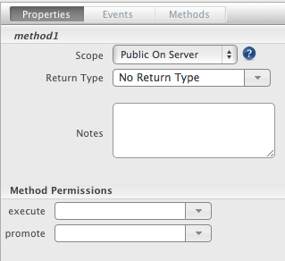
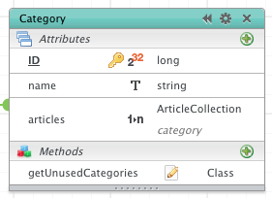
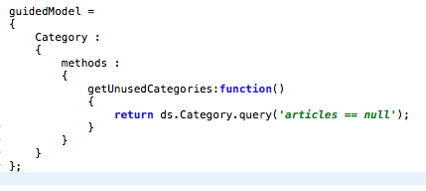
Introduction
Dataclass methods
You can easily add methods from the model designer

Slide 40
Introduction
Dataclass methods
Dataclass methods have a scope:
Private
Can only be used inside the datastore class
Protected
Can be used from datastore classes as well as from derived datastore classes

Slide 41
Introduction
Dataclass methods
Dataclass methods have a scope:
Public on Server
Can be used only from the server
Public
Can be used from anywhere (exposed by the REST API)

Slide 42
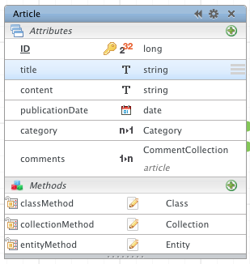
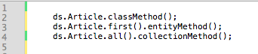
Introduction
Dataclass methods
Examples:

Slide 43
Questions ?

Slide 44

HTTP REST
Wakanda

Slide 45
Introduction
REST API
Wakanda Server provides a REST API that allows you to:
Retrieve information about the datastore classes
Manipulate data
Authenticate a user
…

Slide 46
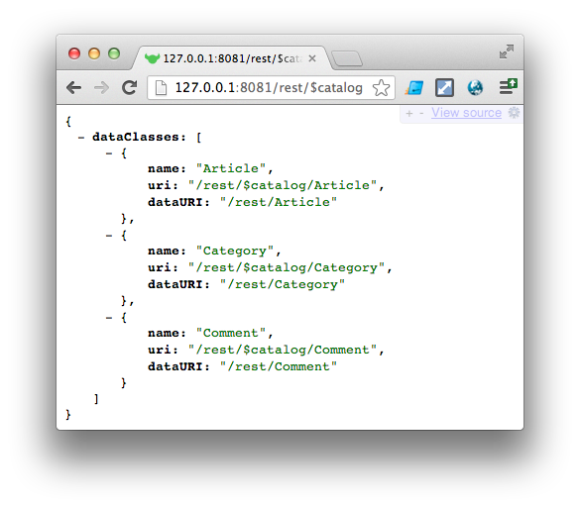
Introduction
Datastore information
/rest/$catalog
Returns a list of the dataclasses in your project with two URIs:
One to access structure information
Another one to retrieve the data in the dataclass

Slide 47
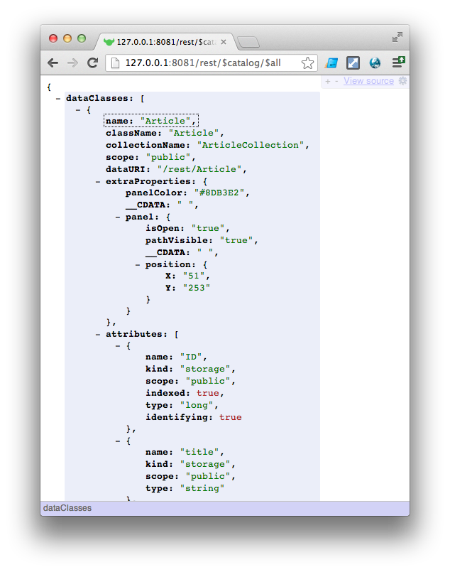
Introduction
Datastore information
/rest/$catalog/$all
Returns information about all of your dataclasses and their attributes

Slide 48
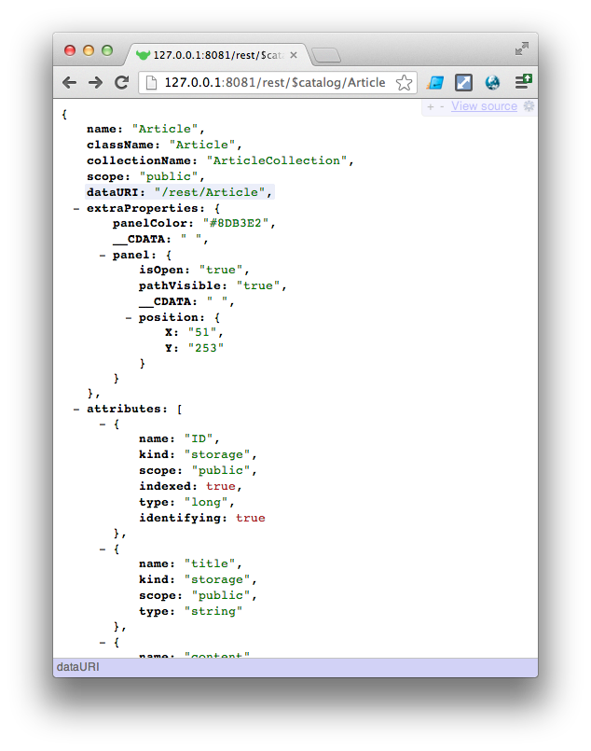
Introduction
Datastore information
/rest/$catalog/{dataClass}
Returns information about a specific dataclass and the attributes it contains

Slide 49
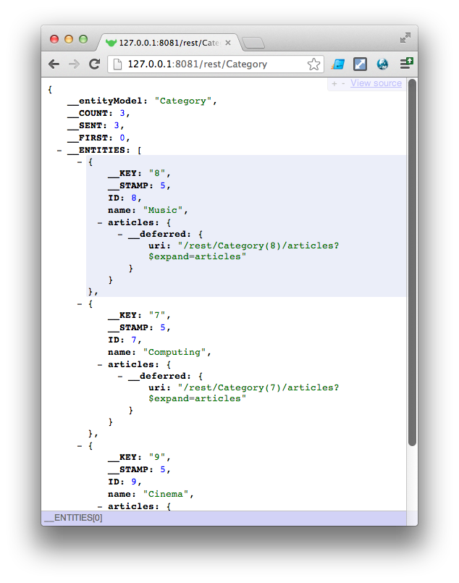
Introduction
Manipulate data
/rest/{dataClass}
Returns all the entities (by default the first 100) for a specific dataclass

Slide 50
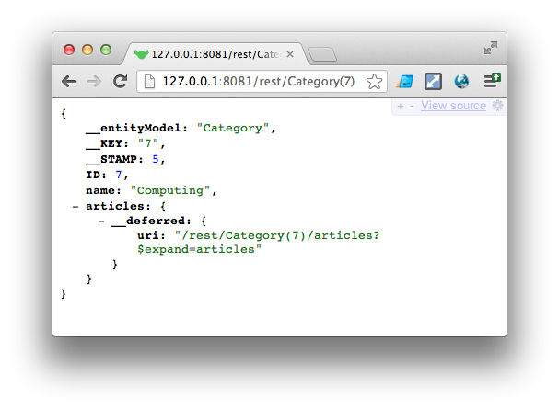
Introduction
Manipulate data
/rest/{dataClass}({key})
Returns the entity defined by the dataclass’s key

Slide 51
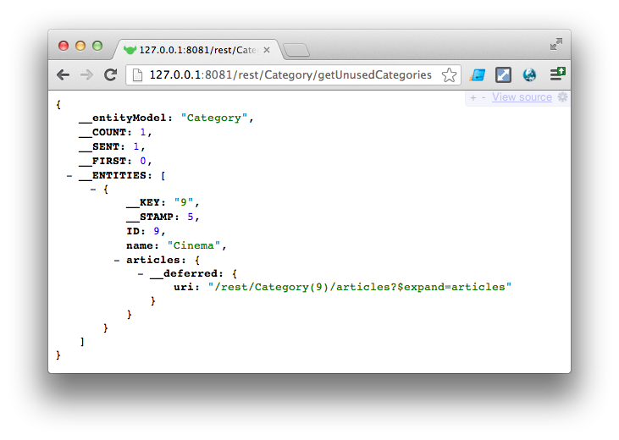
Introduction
Manipulate data
/rest/{dataClass}/{method}
Returns an entity collection or an array based on a dataclass method
Notes:
The scope for a datastore class method must be Public for you to be able to call it in a REST request.
If you do not have the permissions to execute the datastore class method, you will receive the following error:
{ "__ERROR": [ { "message": "No permission to execute method getHighSalaries in dataClass Employee", "componentSignature": "dbmg", "errCode": 1561 } ] }

Slide 52
Introduction
Manipulate data
A lot of other REST Resources are available to manipulate data:
http://doc.wakanda.org/home2.en.html#/HTTP-REST/Manipulating-Data.201-808590.en.html
What you have to remember:
Almost all you can do with a Dataclass object can be done with the REST API !

Slide 53
Questions ?

Slide 54
Dataprovider
Wakanda

Slide 55
Introduction
Dataprovider API
Part of the client-side Framework (WAF)
Provide an abstract way to use the REST API
No need to handle HTTP requests and parse data
Just manipulate data the same way than on the server

Slide 56
Introduction
WAF Loader
To use this API on your HTML page, you just need to include the WAF Loader script :
<script type="text/javascript" src="/waLib/WAF/Loader.js"></script>

Slide 57
Introduction
Client-side Datastore object
As on server-side, a ds property is defined
Client-side version of the Datastore object
The significant difference between the two versions :
The client-side version was designed to work asynchronously !

Slide 58
Introduction
Client-side Datastore examples
Server-side version (synchronous):
Client-side version (asynchronous):
var articles = ds.Article.all();
// Do something with articles
ds.Article.all( function(event) {
var articles = event.entityCollection;
// Do something with articles
});

Slide 59
Introduction
Client-side Datastore examples
Another possible client-side version:
ds.Article.all({
onSuccess: function(event) {
var articles = event.entityCollection;
// Do something with articles
},
onError: function(event) {
console.log(event.error.join(' / '));
// Do something
}
});

Slide 60
Introduction
Client-side Datastore examples
Client-side version of the query method:
ds.Article.query('title = :1', {
params: [ 'B' + WAF.wildchar ],
onSuccess: function(event) {
var beginningWithB = event.entityCollection;
// Do something with articles
},
onError: function(event) {
console.log(event.error.join(' / '));
}
});

Slide 61
Introduction
Client-side Datastore examples
Client-side version of the save method:
var theGuy = ds.People.newEntity();
theGuy.lastName.setValue("Last name"); theGuy.firstName.setValue("First name");
theGuy.save({
onSuccess: function(event) {
console.log('ID:' + event.entity.ID.getValue());
},
onError: function(error) {
console.log(event.error.join(' / '));
}
});

Slide 62
Questions ?

Slide 63
DataSource
Wakanda

Slide 64
Introduction
Concept
A Datasource contains data and automatically generates events when this data is changed
Your code and widgets can subscribe to these events and take appropriate actions

Slide 65
Introduction
Concept
A Wakanda datasource can be based on five different data origins:
Dataclass (use the data provider)
Relation Attribute Datasource
Variable
Array
Object

Slide 66
Introduction
Datasources based on Dataclass
A Wakanda datasource can be based on five different data origins:
Dataclass (use the data provider)
Relation Attribute Datasource
Variable
Array
Object

Slide 67
Introduction
Create a Datasource
You have two ways to create a Datasource:
With Wakanda Studio on a webpage editor
Dynamically with JavaScript code

Slide 68
Introduction
Create a Datasource - JavaScript
// Dataclass Datasource
WAF.dataSource.create({
id: 'article', // Datasource name
binding: 'Article', // Name of the dataclass
'data-source-type': 'dataClass'
});
// Relation Attribute Datasource
WAF.dataSource.create({
id: 'articleComments',
binding: 'article.comments',
'data-source-type': 'relatedEntity'
});
Notes:
http://doc.wakanda.org/Datasource/Advanced-Features/Creating-a-datasource-dynamically.300-971912.en.html

Slide 69
Introduction
Create a Datasource - JavaScript
// Local Variable Datasource
var myAge = 25;
WAF.dataSource.create({
'id': 'age',
'binding': 'myAge', // Target JavaScript variable name
'data-source-type': 'scalar',
'data-dataType': 'number'
}).sync(); // to synchronize the new datasource
Notes:
http://doc.wakanda.org/Datasource/Advanced-Features/Creating-a-datasource-dynamically.300-971912.en.html

Slide 70
Introduction
Create a Datasource - JavaScript
// Local Object Datasource
var myPerson = { name: 'John', age: 45 };
WAF.dataSource.create({
'id': 'person',
'binding': 'myPerson',
'data-source-type': 'object'
}).sync();
Notes:
http://doc.wakanda.org/Datasource/Advanced-Features/Creating-a-datasource-dynamically.300-971912.en.html

Slide 71
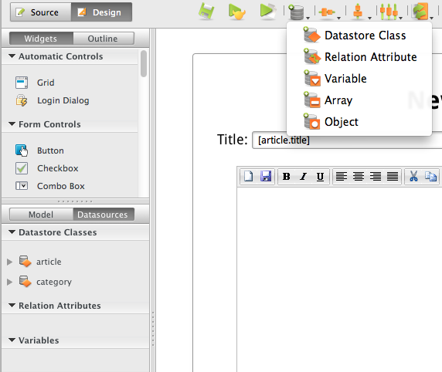
Introduction
Create a Datasource – Wakanda Studio
Create a new Datasource
Datasources

Slide 72
Questions ?

Slide 73



Thanks for your attention

